Slide 1
Collection and Generics

Slide 2

Learning Objectives Exception
Collection Interface
List
Set
Map
Iteration
Collection implementation classes
Generics
Comparator and Comparable Interface

Slide 3
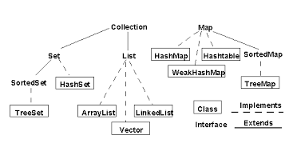
Collection Interface
The Java collections framework (JCF) is a set of classes and interfaces that implement commonly reusable collection data structures. The JCF provides both interfaces that define various collections and classes that implement them.

Slide 4
Generics
The Java Generics programming is introduced in J2SE 5 to deal with type-safe Objects. Before generics, we can store any type of objects in collection i.e. non-generic. Now generics, forces the java programmer to store specific type of objects.
Advantage of Java Generics
1)Type-safety : We can hold only a single type of objects in generics. It doesn’t allow to store other objects.
2)Type casting is not required: There is no need to typecast the object.
3)Compile-Time Checking: It is checked at compile time so problem will not occur at runtime.

Slide 5
List
A List is an ordered Collection (sometimes called a sequence).
Lists may contain duplicate elements. It represents an ordered list of objects, meaning you can access the elements of a List in a specific order, and by an index too.
Implementing class of List
Array List
Linked List
Vector
Stack

Slide 6
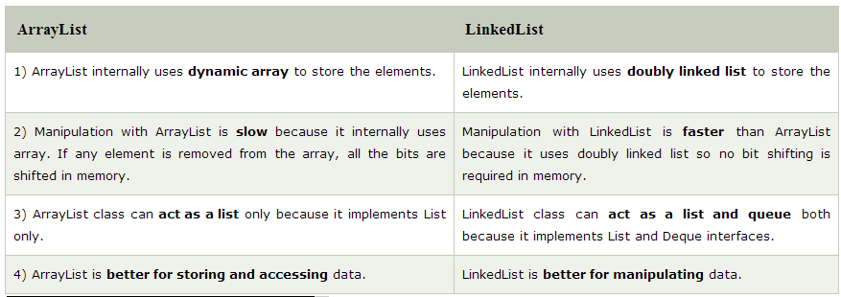
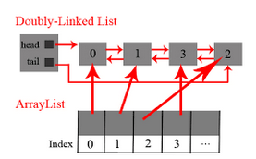
List Contd.

Slide 7
Iteration of Collection
Iteration is a process retrieve the list in sequential order. In Java there are 5 ways in which we can iterate the list
For Loop
Advanced For Loop
Iterator
While Loop
Collection's stream() util (Java8)

Slide 8
Set
A Set is a Collection that cannot contain duplicate elements. It represents set of objects, meaning each element can only exists once in a Set.
Implementation Class of Set
java.util.HashSet -- makes no guarantees about the sequence of the elements when you iterate them.
java.util.LinkedHashSet -- guaranteeing that the order of the elements during iteration is the same as the order they were inserted into the LinkedHashSet.
java.util.TreeSet -- guarantees the order of the elements when iterated, but the order is the sorting order of the elements.

Slide 9
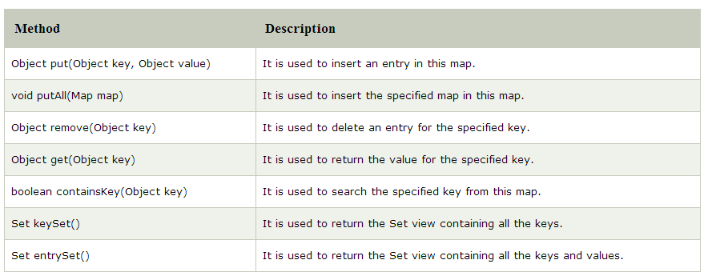
Map
A map contains values on the basis of key i.e. key and value pair. Each key and value pair is known as an entry. Map contains only unique keys.
Map is useful if you have to search, update or delete elements on the basis of key.
.

Slide 10
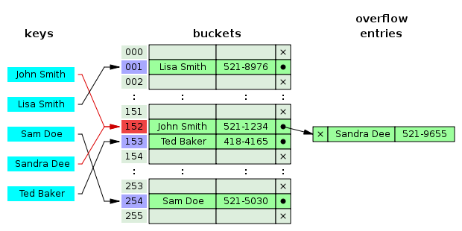
Map Contd.

Slide 11
Comparable
This interface is used to sort a collection, By default all the Wrapper class [String, Integer, Float, Double ] implements comparable interface for natural order storing.
For ex: Collections.sort(fruits);
public int compareTo(Fruit compareFruit) {
int compareQuantity = ((Fruit) compareFruit).getQuantity();
//ascending order return this.quantity - compareQuantity;
//descending order //return compareQuantity - this.quantity;
}

Slide 12
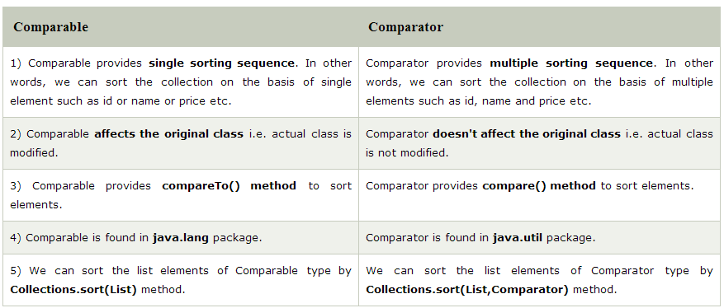
Comparator
This interface is used to sort a collection for doing sorting for more than one sorting.

Slide 13
What are we learning in Next Chapter ?
Live Projects

Slide 14
Thank You !

